Slide 1
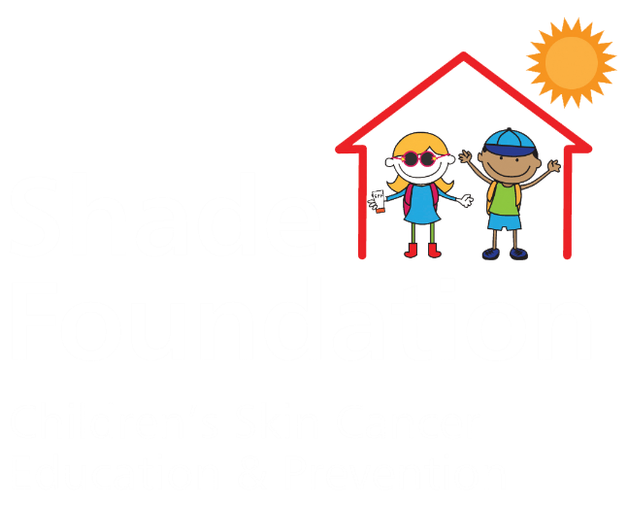
Shade Foundation
Educational Program

Slide 2
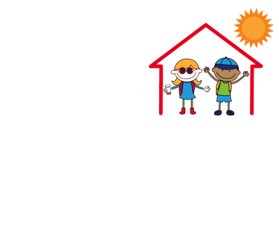
Welcome!
Thanks so much for choosing to partner with Shade for your upcoming service project!
Your time and energy will help to prevent melanoma by promoting education and awareness in your community. Whether you have a project in mind or are looking for ideas, we’ve got you covered. Read on to learn about the next steps.

Slide 3
3 Steps
in Service Projects

Slide 4
Step 1.
Education.
Become a Shade star and learn about how to limit the sun, not the fun.

Slide 5
Step 1. Education
There are a lot of myths about sun safety and skin cancer out there. Before beginning your project, make sure you are an expert by prepping with the EPA’s SunWise educational resources. We all have more to learn when it comes to staying safe in the sun, and preparing with SunWise is a Shade service project must!

Slide 6
Step 2.
Preparation
Get ready to translate your knowledge into action!

Slide 7
Step 2. Preparation
Translate your knowledge into service! Whether you are preparing informational flyers, making a poster, or making template letters to send to your school board about sun safe policies, put your SunWise expertise to work preparing to spread the word about melanoma prevention.

Slide 8
Step 3.
Implementation
Bring your project to life and share your work with us along the way!

Slide 9
Step 3. Implementation
Spread the word about sun safety! Here are some potential project ideas. Feel free to adapt these to your age and interest, or create your own.

Slide 10
Step 3. Implementation
Grade K - 5
Make a video or brochure to share with students at your school
Make fliers to educate others about sun safety and pass them out at your local pool

Slide 11
Step 3. Implementation
Grade 6 - 8
Seek permission to make a sun safety mural at your school or local park
Start a campaign to get more shade spaces at your school or local park
Raise funds to donate hats or sunglasses to your local clothing bank. Be sure to include sun safety educational materials for the recipients!

Slide 12
Step 3. Implementation
Grade 9 - 12
Contact local schools to encourage them to adopt sun safety policies
Start a campaign to get sun safe uniforms for the sports teams at your school
Is there room for improvement in your state’s indoor tanning legislation? Write to your local legislators to encourage them to protect kids from harmful indoor ultraviolet rays

Slide 13
Share Your Shade Story!
Keep track of the time you devoted to melanoma education and prevention by using the Shade log sheet. Don’t forget to share your progress along the way with #ShadeStory and #ShadeFoundation.
We can’t wait to see your knowledge put to action to prevent melanoma in your community!

